Slide 1


APPLICATION OF PRINCIPLE OF INCLUSION AND EXCLUSION
ASSIGNMENT-1
PRESENTED BY Madhurima Rawat ROLL NO-$300012821042$ DATASCIENCE(CSE)
Chhattisgarh Swami
Vivekananda Technical
University

Slide 2
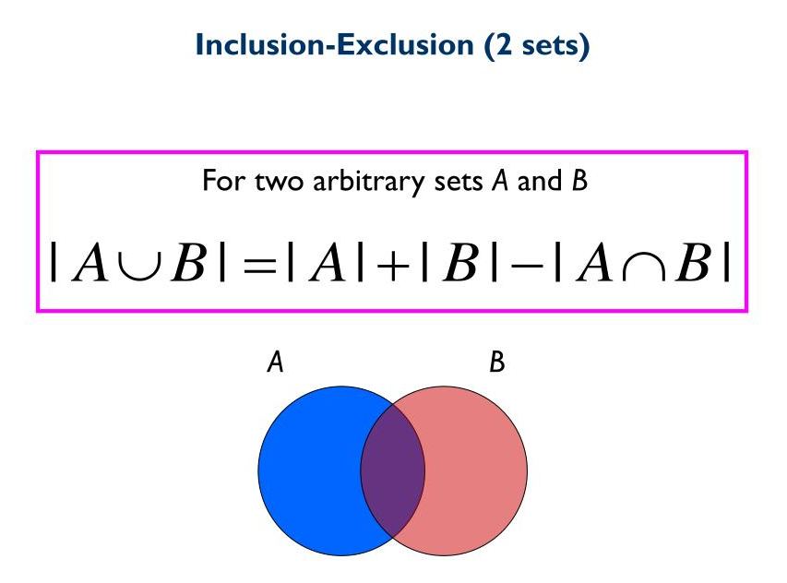
Principle of Inclusion and Exclusion
Principle of inclusion and exclusion is an approach which derives
the method of finding the
number of elements in the union of two
finite sets.
This is used for solving combinations
and probability problems when it is
necessary to find a counting method,
which makes sure that an object is not counted twice.

Slide 3
Counting derangements
The number of rearrangements, if n things are arranged in a row, such that none of them will occupy their original positions are called derangements.
A well-known application of the inclusion–exclusion principle is to the combinatorial problem of counting all derangements of a finite set. A derangement of a set A is a bijection from A into itself that has no fixed points. Via the inclusion–exclusion principle one can show that if the cardinality of A is n, then the number of derangements is [n! / E] where [x] denotes the nearest integer to x.

Slide 4
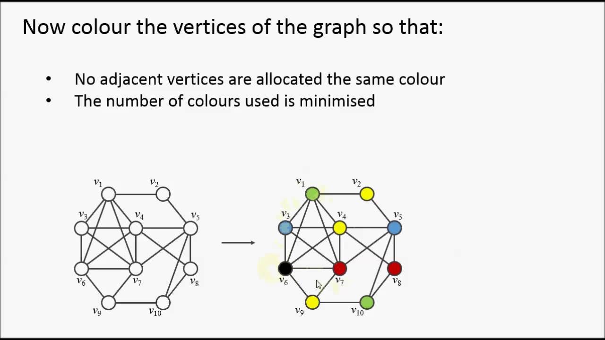
Graph coloring
The inclusion exclusion principle forms the basis of algorithms for a number of np-hard graph partitioning
problems, such as graph coloring.
A well known application of the principle is
the construction of the chromatic polynomial
of a graph.

Slide 5
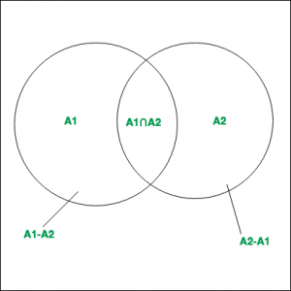
In discrete mathematics
In the field of combinatorics, it is a counting method used to compute the cardinality of the union set. According to basic inclusion-exclusion principle:
Properties :
Computes the total number of elements that satisfy
at least one of several properties.
It prevents the problem of double counting.

Slide 6
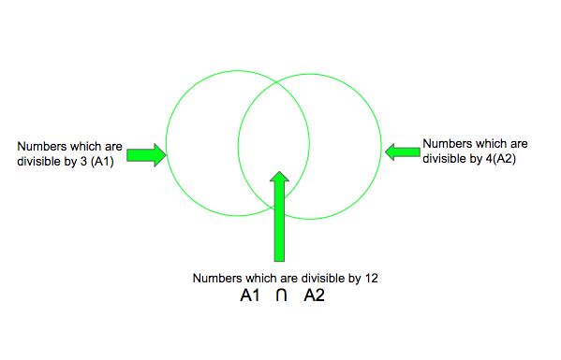
programming applications
Numbers between 1 and 1000, including both, are divisible by 3 or 4
We add the number of numbers that
Are Divisible by 3 and 4 and subtract
the numbers which are divisible by 12.
Therefore, number of numbers divisible
By 3 or 4 =333 + 250 – 83 = 500

Slide 7
Coding implementation in c++
// cpp program to count the
// number of numbers between
// 1 and 1000, including both,
// that are divisible by 3 or 4
#include <bits/stdc++.h>
using namespace std;
// function to count the divisors
int countdivisors(int n, int a, int b){
// counts of numbers
// divisible by a and b
int count1 = N / a;
int count2 = N / b;
// inclusion-exclusion
// principle applied
int count3 = (N / (a * b));
return count1 + count2 - count3;}
// Driver Code
int main(){
int N = 1000, a = 3, b = 4;
cout << countDivisors(N, a, b);
return 0; }

Slide 8
output
The output of this code is :
500
Which is the number of Numbers between 1 and 1000, including both, are divisible by 3 or 4

Slide 9
One more programming application
Given N prime numbers and a number M, find out how many numbers from 1 to M are divisible by any of the N given prime numbers.
The approach for this problem will be to generate all the possible combinations of numbers using n prime numbers using power set in 2^{n}. For each of the given prime numbers p_{i} among N, it has M/p_{i} multiples. Suppose M=10, and we are given with 3 prime numbers(2, 3, 5), then the total count of multiples when we do 10/2 + 10/3 + 10/5 is 11. Since we are counting 6 and 10 twice, the count of multiples in range 1-M comes 11. Using inclusion-exclusion principle, we can get the correct number of multiples.

Slide 10
Coding implementation in c++
#include <bits/stdc++.h>
using namespace std;
int count(int a[], int m, int n){
int odd = 0, even = 0;
int counter, i, j, p = 1;
int pow_set_size = (1 << n);
for (counter = 1; counter <pow_set_size;counter++){
p = 1;
for (j = 0; j < n; j++) { if(counter & (1 << j)) {
p *= a[j]; } }
if(__builtin_popcount(counter) & 1)
odd += (m / p);
else
even += (m/ p);}
return odd - even; }
int main() {
int a[] = { 2, 3, 5, 7 };
int m = 100;
int n = sizeof(a) / sizeof(a[0]);
cout << count(a, m, n);
return 0; }
Output is : 78

Slide 11
THANK YOU FOR LISTENING TO MY PRESENTATION
ANY QUESTIONS

